Slide 1
Data Scientist Challenge
https://www.datascientistchallenge.com/
by Citi Group

Slide 2
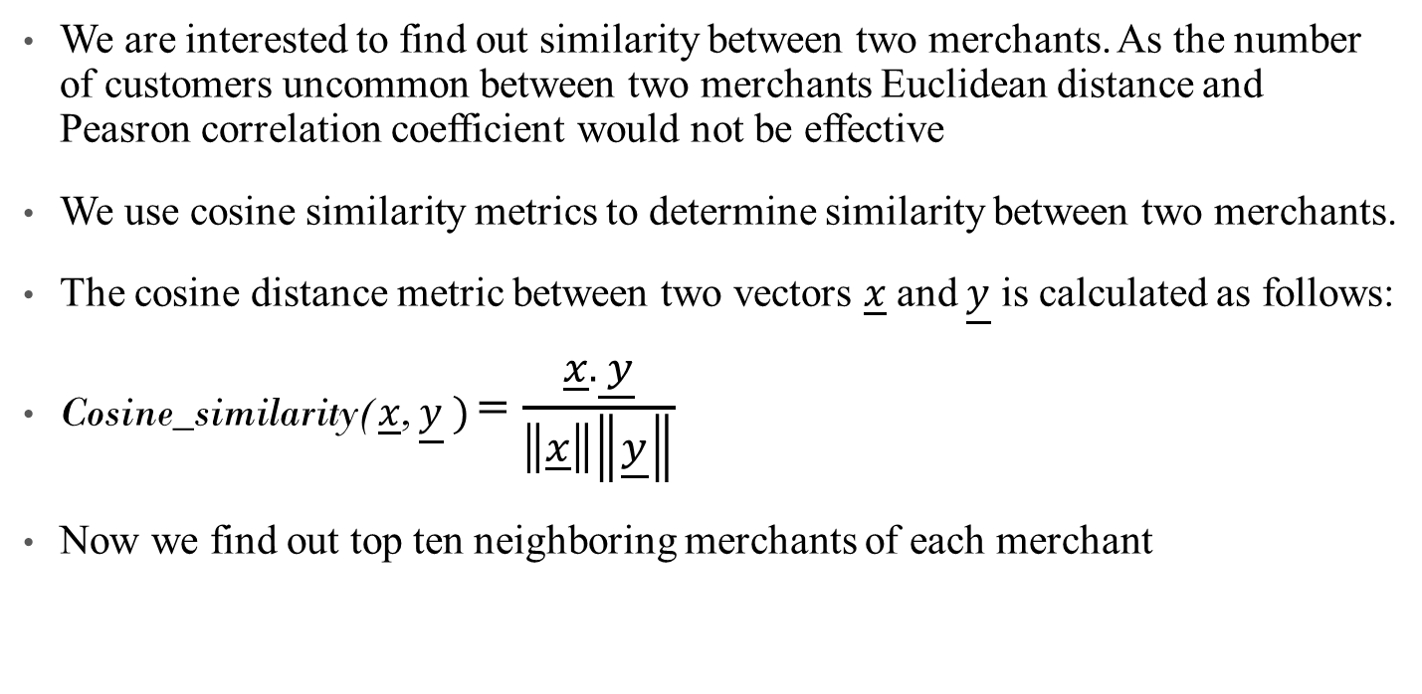
Cosine Similarity

Slide 3
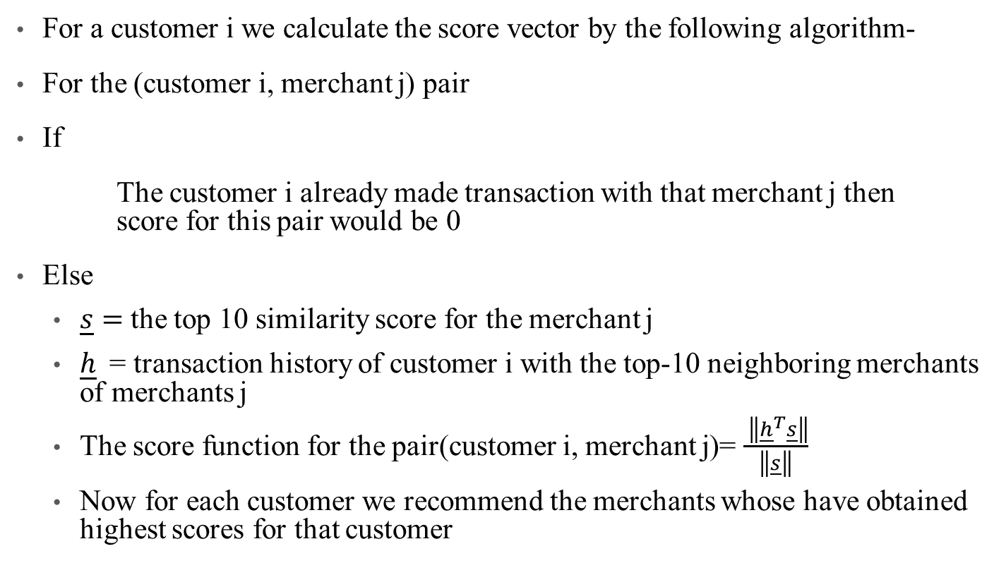
Generating Score function for each customer

Slide 4

IRLBA

Slide 5
What is IRLBA?
The Implicitly Restarted Lanczos bidiagonalization algorithm (IRLBA) of Jim Baglama and Lothar Reichel is a state of the art method for computing a few singular vectors and corresponding singular values of huge matrices.
With it, computation of partial SVDs and principal component analyses of very large scale data is very time and space -efficient. The package works well with sparse matrices.

Slide 6
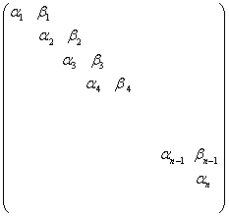
SVD and IRLBA
The singular value decomposition (SVD) of an m×n c matrix A can be written as A = UΣV^{T}
For Lanczos Bidiagonalization we consider a trimmed version
A = P_{n}B_{n}Q_{n}^{T}
Here B_{n} will of the special form:
Notes:
where the zero rows of the bidiagonal matrix have been removed and, therefore, Pn is now an m × n matrix with orthonormal columns, Qn is a unitary matrix of order n, and Bn is the

Slide 7
Bidiagonalization Algorithm
Expressions can be written in vector form by equating the jth column
Aq_{j} = β_{j-1} p_{j−1} + α_{j}p_{j},
A^{T}p_{j} = α_{j}q_{j} + β_{j}q_{j+1}.
From This we can obtain the recursive relation:
α_{j}p_{j} = Aq_{j} −β_{j−1}p_{j−1}
β_{j}q_{j+1} = A^{T}p_{j} −α_{j}q_{j}

Slide 8
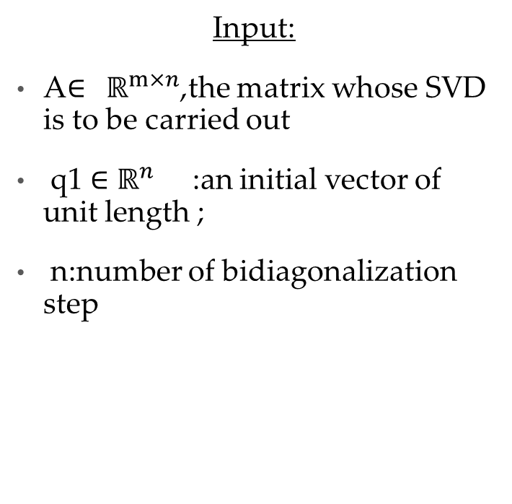
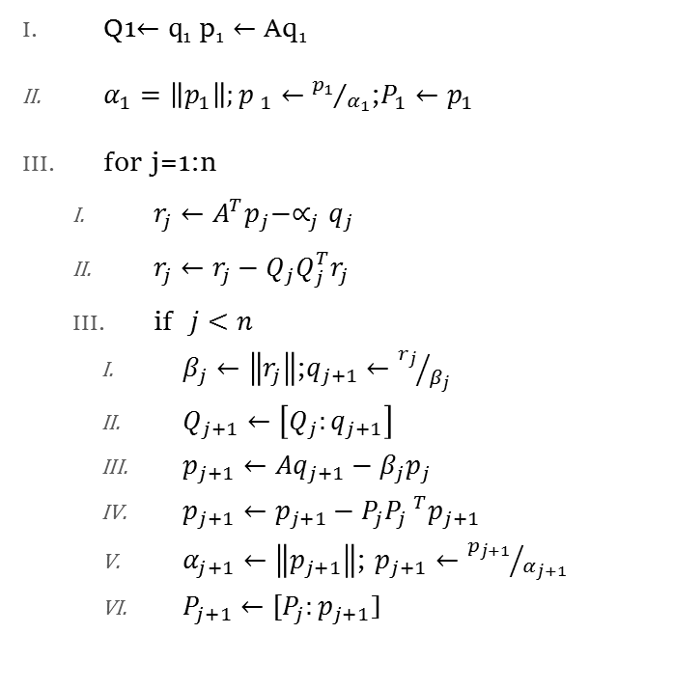
Partial Lanczos Bidiagonalization:Algorithm

Slide 9
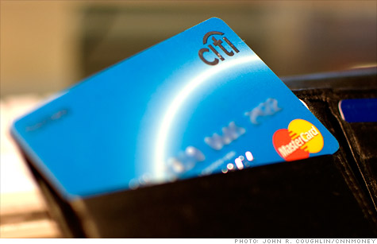
Credit Card Industry
Information rich data
Millions of customers
Transaction data is one good data source
On average approximately 120 annual records are created for each active customer.
Incredible insights into customer preferences and lifestyle choices.
Sheer size of the data and the processing power required,

Slide 10
Objective
The objective of this challenge is to identify the Top 10 merchants that customers have not transacted within the past 12 months and are likely to transact with, in the next 3 months.
Personalize these recommendations at a customer level
Can be used to give customized offers from those merchants to customer, from whom he is likely to shop.
Prime business reason behind all this analysis

Slide 11
Data Format
Customer # | Merchant # | Month | Category | # of transactions
1 | 1 | 1 | Grocery | 3
2 | 2 | 1 | Dining | 2
3 | 3 | 1 | Grocery | 5
4 | 4 | 2 | Apparel | 1

Slide 12
Data Summary
No missing data
Data size = 690.5 mb
dim(citi_data) [1] 18532355 5
range(citi_data$TXN_MTH) [1] 201309 201408
The16 categories are disjoint sets with merchants

Slide 13
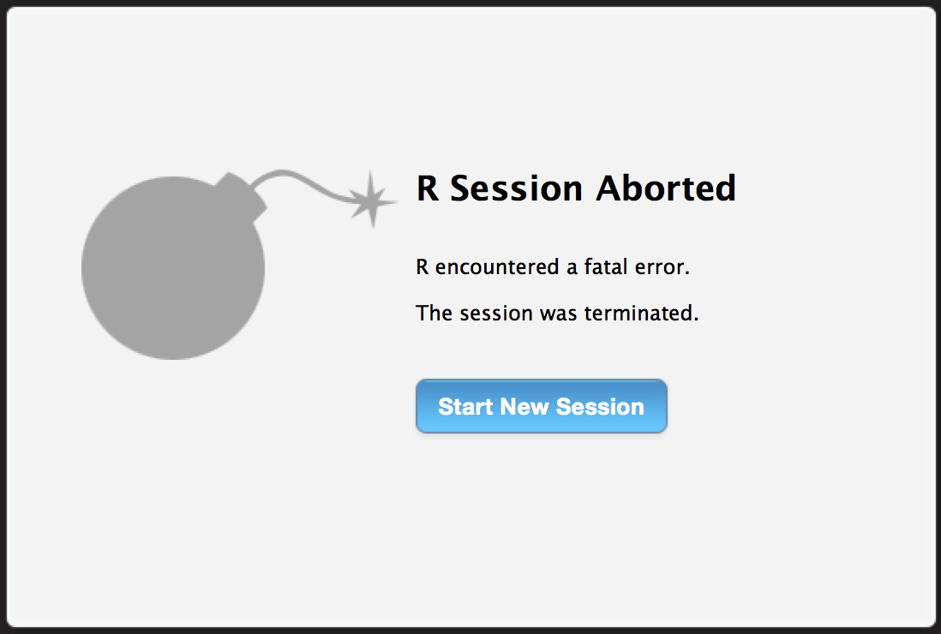

Slide 14
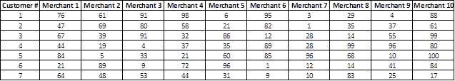
Scoring
If Merchant 1 has been identified correctly for a customer, 10 points are added to the score. Correctly identifying Merchant 2 adds 9 points, and so on.
Code to be executed on a High Performance Machine with 96 GB RAM.
Algorithm should run within 12 hours in terms of execution time.

Slide 15
Category of Problem
It was a collaborative filtering problem, where people can be recommended about items with similar taste have bought before.

Slide 16
Approaches Tried
Naive approach:
Find out the weightage of categories for individual customer, based on number of transactions.
Find best merchants in each of the categories.
For a customer, we know which are his/her most important category. Find out the merchants they transacted with in the last 1 year in each category.
Subtract the merchant customer has transacted in the past 1 year from the best merchants in the category. Recommend the top 10 merchants for customer for categories based on the weightage of categories.

Slide 17
Approaches Tried (Continued...)
Data seems to be time (quarter) independent. But still we need to provide some additional weightage to the 1st quarter as we need to predict for next 1st quarter. Thus a detailed time series analysis doesn’t seem to be appropriate. (¼th of the total time duration we need to predict). However we should give some importance to transactions in the 1st quarter of data since there could be cyclicity in terms of annual transactions.

Slide 18
Approaches Tried (Continued...)
Matrix factorization based collaborative filtering:
Create a matrix which is a Customer x Merchant Matrix. Each element represents the number of transactions a customer has done with the specific matrix. Since normal matrix of size 3,75,000 x 10,000 was not possible, so we create a sparse matrix.
We factorized the sparse matrix doing SVD using “Irlba” package.
We did SVD using 10,20,30,50,75,100,125,150,200 rank approximations
We reconstruct one row of the original at a time by doing Ui X Eii X Vi

Slide 19
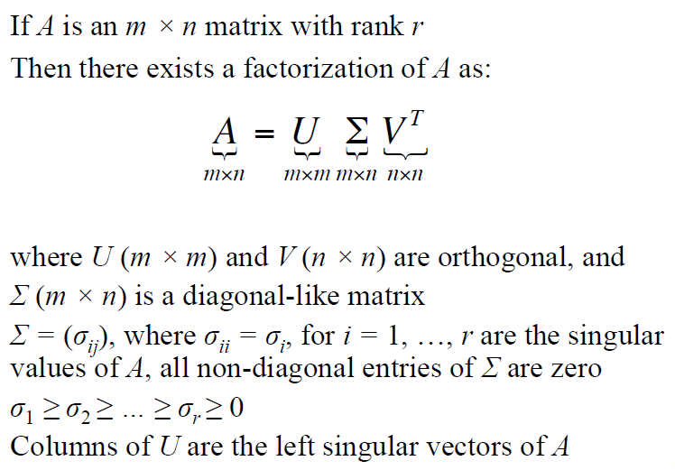
Singular Value decomposition

Slide 20
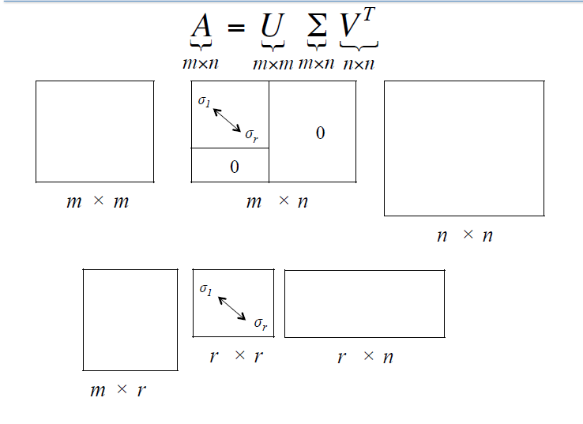
Singular value decomposition

Slide 21
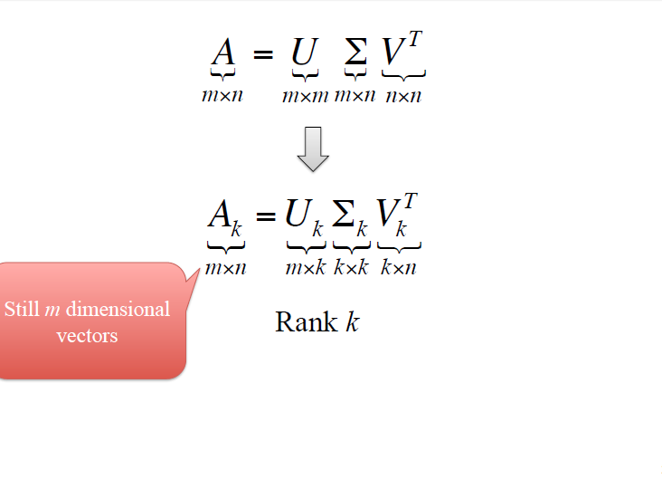
K-Rank Approximation

Slide 22
Approaches Tried (Continued...)
Reconstruction of a row, representation of behaviour which is expected behaviour for a particular customer. This means the row we get after re construction gives an idea of, which merchants the customer would have bought normally.
So we take the difference of this reconstructed row from the original given row and see that, which are the entries in the row which changed from zero to nonzero.
These elements will give the merchants from whom the customer are expected to buy. So we select the 10 merchants and recommend for that customer.

Slide 23
Verifying for the algorithm
Slicing and dicing and then ensembling the data
For verifying the algorithm, took first 9 month data
Predicted for next 3 months
Compared with the data which we have.
Random samples of 10,000 customers were taken for each trial.
Keep taking samples and average if value already exists.

Slide 24
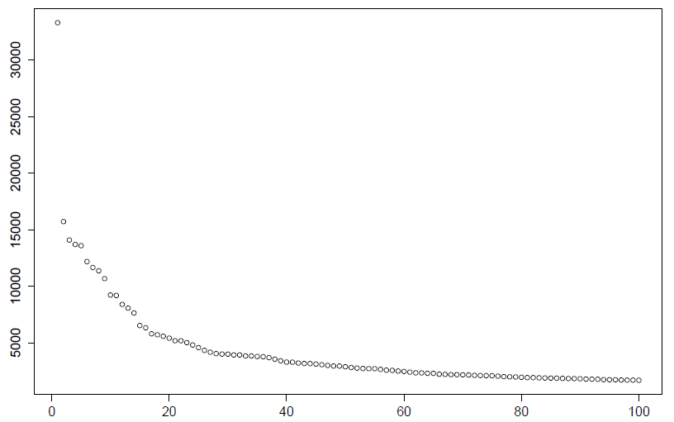
Plot of 1st 100 eigen values

Slide 25
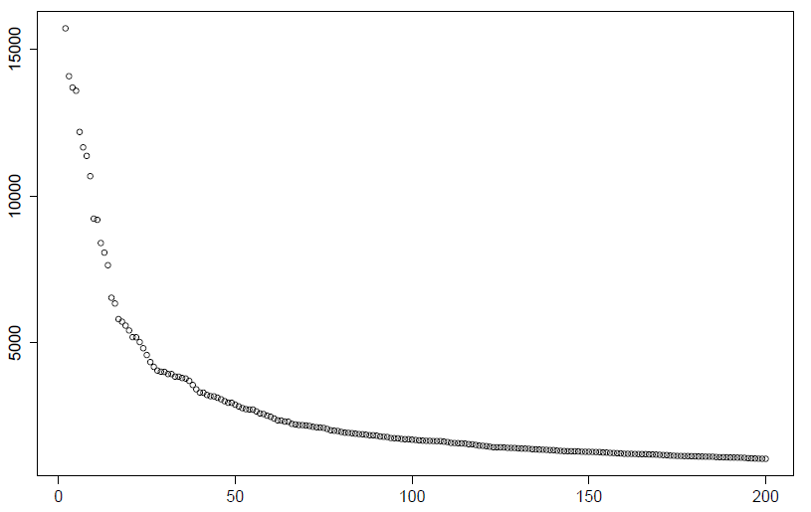
Plot of 2nd to 200th eigen values

Slide 26
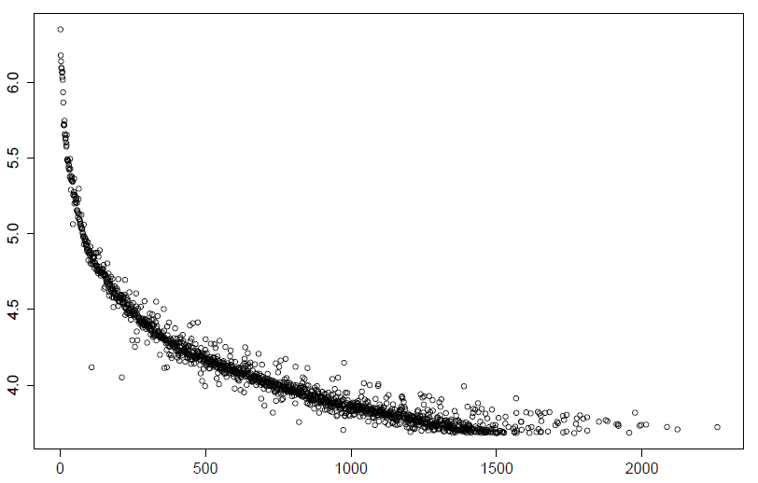
Log-plot of 1st 1500 Merchants by Transactions

Slide 27
SVD based method explained
The reduced orthogonal dimensions resulting from SVD are less noisy than the original data and capture the latent associations
Reducing the dimensionality of the customer-merchant space, we can increase density of the matrix and thereby generate predictions
SVD provides the best lower rank approximations of the original matrix R, in terms of Frobenius norm
The reconstructed matrix Rk = Uk.Sk.Vk’ minimizes the Frobenius norm i.e. || R- Rk || over all rank-k matrices
Even though the Rk matrix is dense, its special structure allows us to use sparse SVD algorithms (e.g. Lanczos) whose complexity is almost linear to the number of nonzeros in the original matrix R.

Slide 28
SVD based method explained
We use SVD in recommender systems to perform 2 different tasks:-
First, we use SVD to capture the latent relationships between customers and merchants that allow us to compute the predicted likeliness of a certain merchant by a customer.
Second, we use SVD to produce a low-dimensional representation of the original customer-merchant space and then compute neighborhood in the reduced space. We then use that to generate a list of top-N product recommendations for customers.

Slide 29
SVD based method explained
The optimal choice of the value ‘k’ is critical to high quality prediction generation.
We are interested in a value of k that is large enough to capture all the important structures in the matrix yet small enough to avoid overfitting errors.
For an m x n matrix the SVD decomposition requires a time in the order of O((m+n)^3)
In terms of storage SVD is efficient. We need to store just two reduced customer and merchant matrices of size m x k and k x n respectively, a total of O(m+n), since k is constant.

Slide 30
References
References for SVD approach -
“Application of Dimensionality Reduction in Recommender System - A Case Study”
Badrul M. Sarwar, George Karypis, Joseph A. Konstan, John T. Riedl
Department of Computer Science and Engineering, University of Minnesota
“Topics in Data Analytics: Collaborative Filtering, Finding Similar Items in Very High Dimension, Sentiment Analysis”
Debapriyo Majumdar
Indian Statistical Institute Kolkata

